Slide 1
Recipe Manager
AnnaAndSteffi Development
Spring 2014

Slide 2
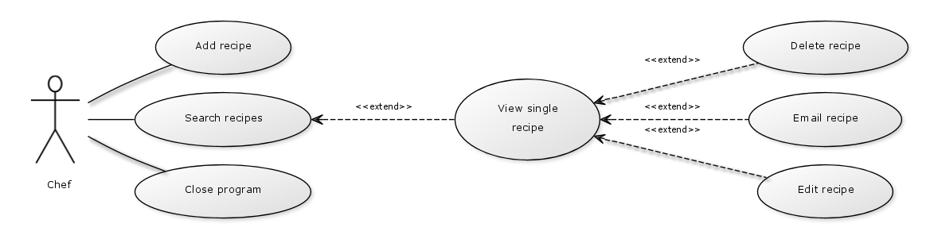
Recipe Manager Use Case

Slide 3
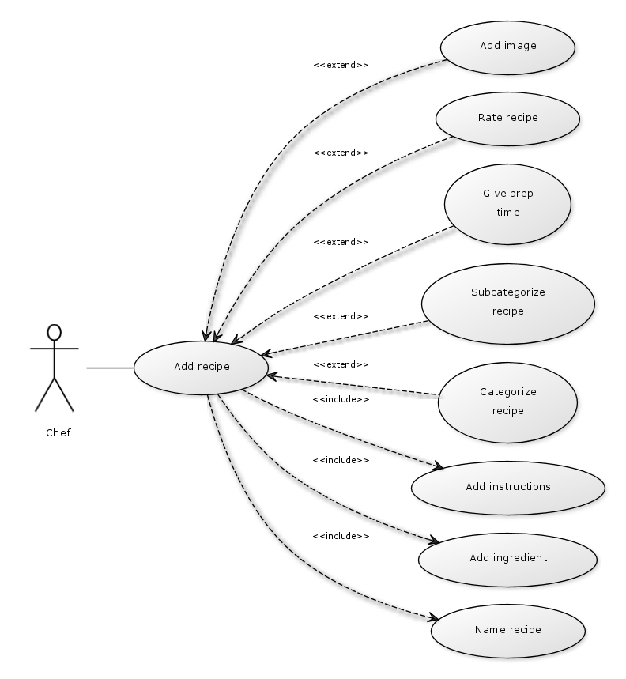
Add Recipe Use Case

Slide 4
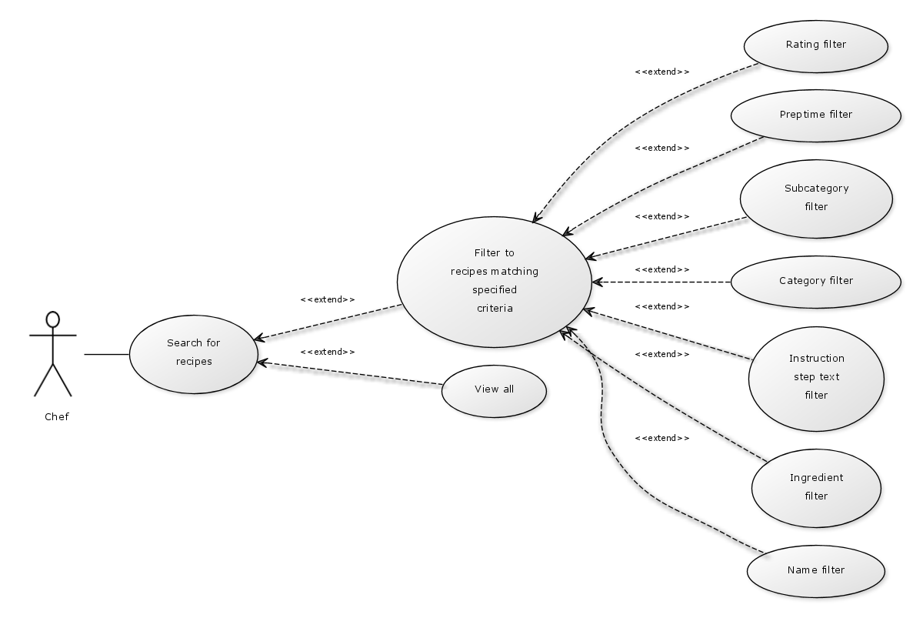
Search for Recipes use case

Slide 5
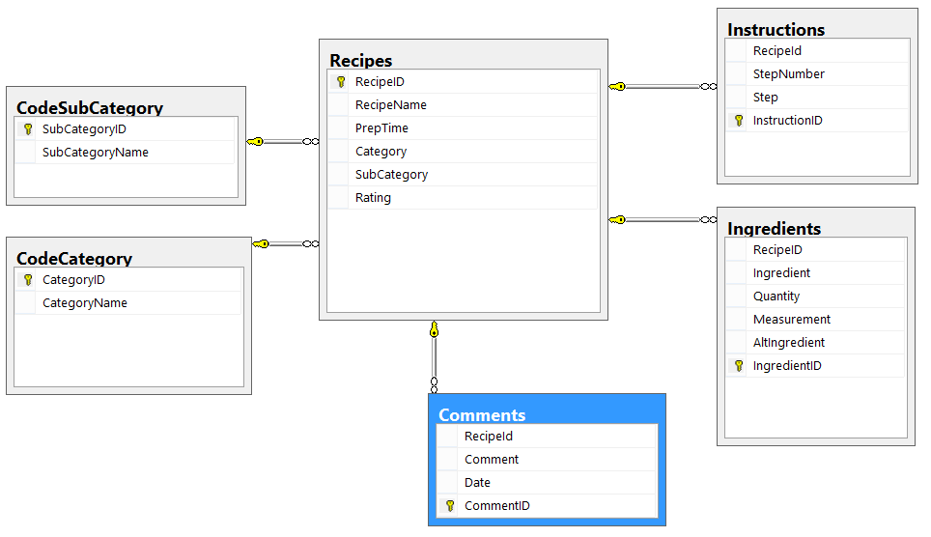
Database Diagram

Slide 6
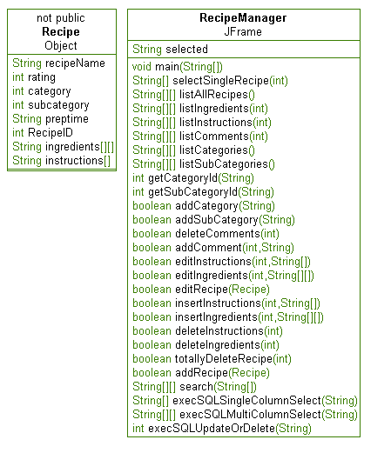
Class Diagrams

Slide 7
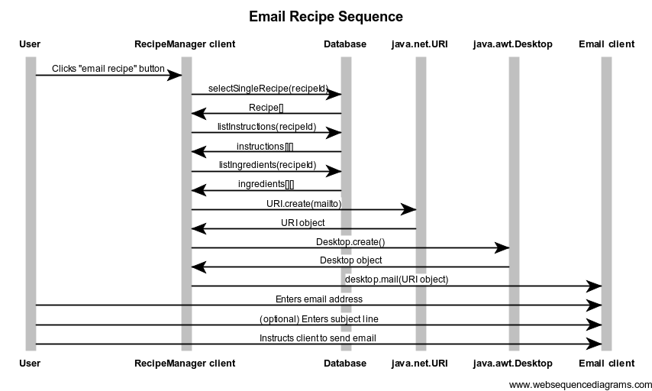

Slide 8
